Slide 1
Inter VLAN Routing
ITP | Institute of IT Professionals
Instructor:
Muhammad Naeem
(MSIT/RHCE/CCNP/CCNA/MCSE)
Cell: 0345-5238281
E-Mail: mna571@yahoo.com

Slide 2
Lecture Overview
What is Inter VLAN Routing?
Port based VLANS
Routed Ports
Configuring Inter VLAN Routing
Using Multilayer Switch
Using Router on a stick
Lab Examples/Practice

Slide 3
What is Inter VLAN Routing?
Inter VLAN Routing
Communication between different VLANs (networks)
Different VLANs behave as if different networks (logically)
Enable Routing /Inter VLAN Routing
Using
Multilayer Switch
Router on a Stick

Slide 4
Port-Based VLANs
Add ports to a VLAN by using the switchport interface configuration commands:
Identify the interface.
For a trunk port, set trunk characteristics and define the VLANs to which it can belong.
For an access port, set and define the VLAN to which it belongs.

Slide 5
Switch Ports
Layer 2-only interfaces associated with a physical port
Access port
Carries the traffic of and belongs to only one VLAN
Trunk port
Carries the traffic of multiple VLANs
By default is a member of all VLANs in the VLAN database
Configure switch ports using the switchport interface configuration commands

Slide 6
Layer 3 Switch Virtual Interfaces
Represent a VLAN of switch ports as one interface to the routing or bridging function in the system
Created the first time that you enter the vlan interface configuration command for a VLAN interface
Configure a VLAN interface for each VLAN for which you want to route traffic, and assign it an IP address
Support routing protocol and bridging configurations

Slide 7
Routed Ports
Routed ports defined:
Physical port that acts like a port on a router
Not associated with a particular VLAN
To configure a routed port:
Enable IP routing within the switch.
Put the interface into Layer 3 mode with the no switchport interface configuration command.
Assign an IP address and subnet mask to the port.
Assign routing protocol characteristics by enabling IP routing.

Slide 8
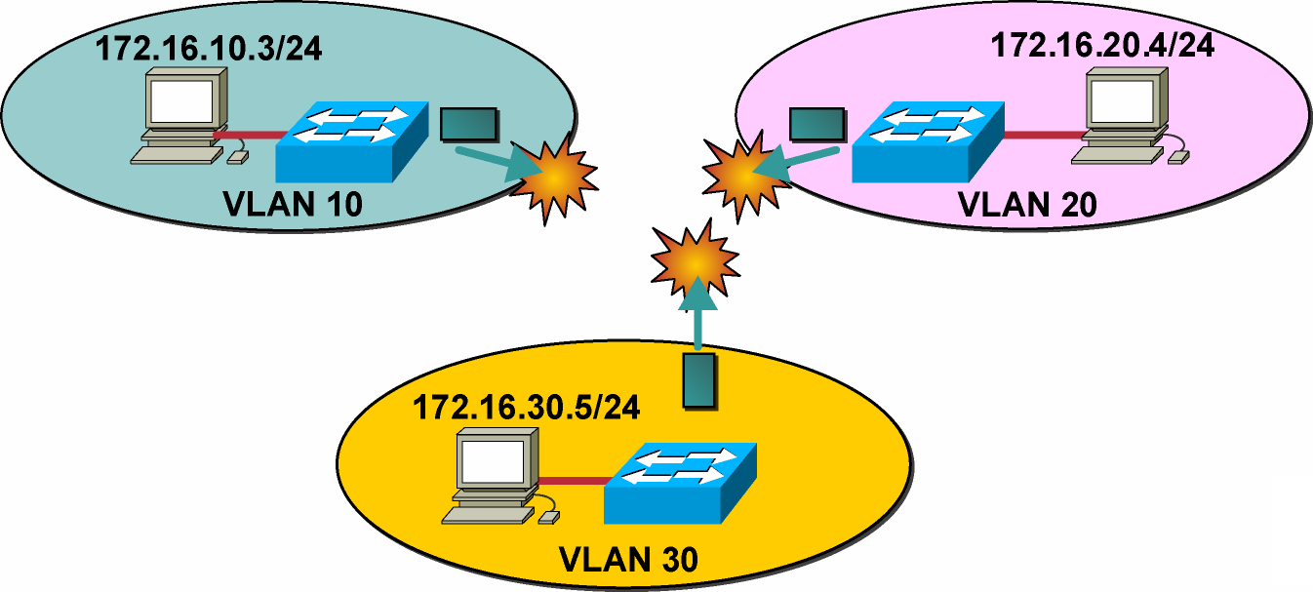
Problem: Isolated Broadcast Domains
Because of their nature, VLANs inhibit (prevent) communication between VLANs.
Notes:
Purpose: This slide poses the problem of communicating between VLANs.
Emphasize:
Point out that VLANs, by their nature, are designed to keep data from traversing the VLAN borders.
However, end users stations need to communicate with entities outside the VLAN borders.
Use the example of end users in one VLAN needed to communicate with enterprise servers residing in a VLAN across the network core.
Transition: Following introduces the solution.

Slide 9
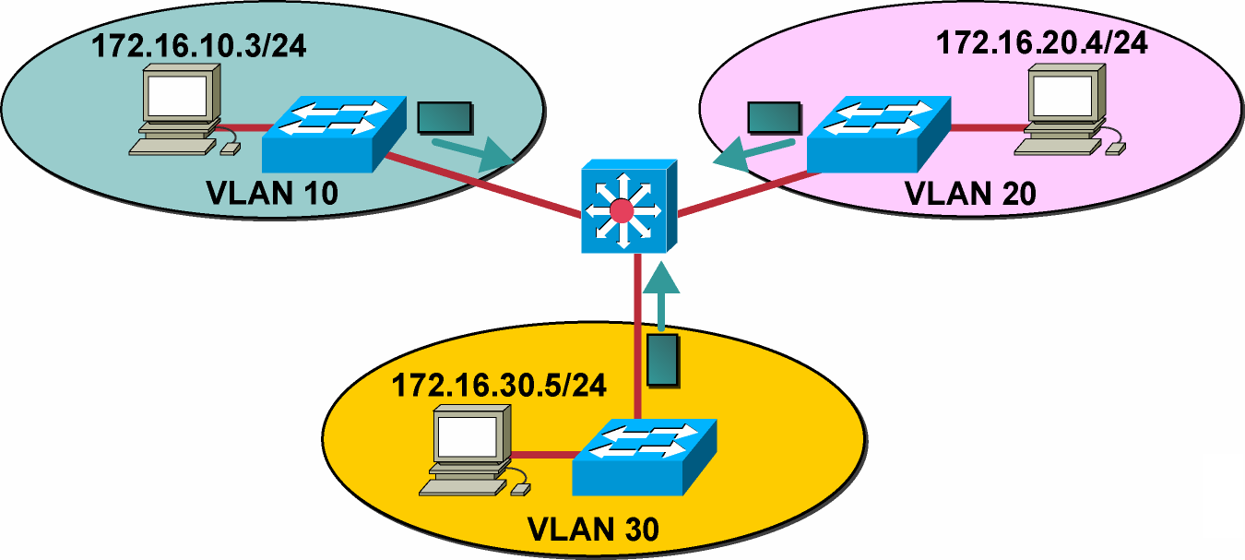
Solution: Routing Between VLANs
Communications between VLANs requires a Layer 3 services module.
Notes:
Purpose: This slide introduces routers as the solution to inter-VLAN communications.
Emphasize:
In switched networks, route processors are used to provide communications between VLANs.
Before you can configure routing between VLANs, you must have defined the VLANs on the switches in your network.
Refer to the Cisco Internetworking Design Guide and appropriate switch documentation for information on these topics.
The Cisco Internetworking Design Guide is available from Cisco Press.
Inter-VLAN Routing is discussed in the Cisco IOS Switching Services Configuration Guide located on the Cisco Documentation CD-ROM.
Transition: Following begins the discussion of some problems that occur as result of inter-VLAN routing.

Slide 10
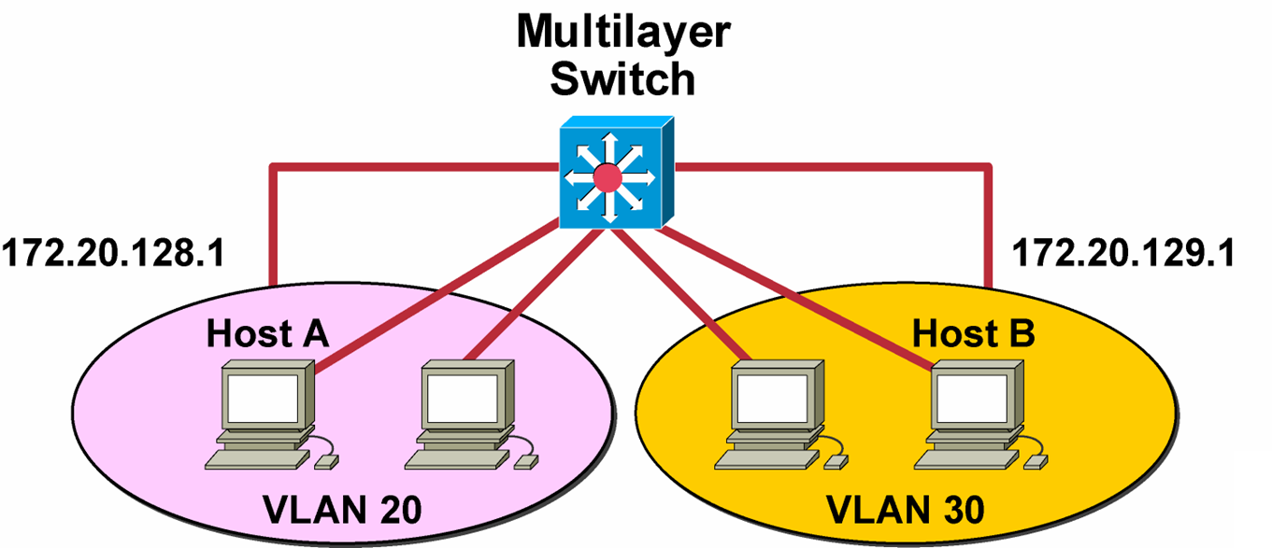
Connecting VLANs with a Multilayer Switch

Slide 11
Configuring Inter-VLAN Routing on a Layer3 Switch
Switch(config)#ip routing
Enables IP routing on the switch
Switch(config)#router ip_routing_protocol <options>
Specifies the IP routing protocol (optional command)
Switch(config)#Vlan vlan-id
Create a VLAN
Switch(config)#interface vlan-id
Enters interface configuration mode for a specific VLAN
Switch(config-if)#ip address n.n.n.n subnet-mask
Assigns an IP address to the VLAN

Slide 12
Router on a stick

Slide 13
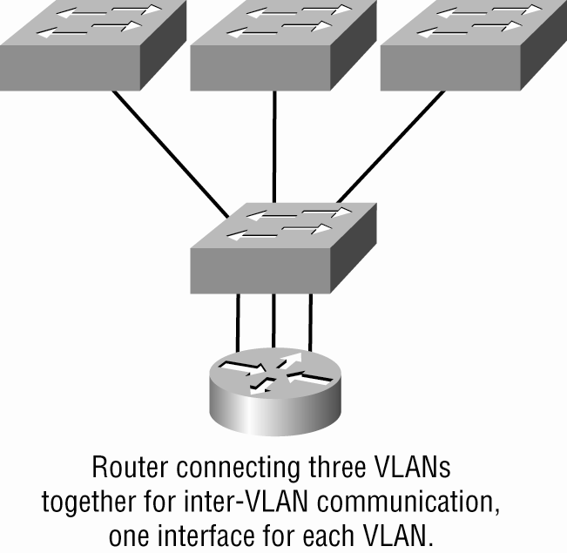
Router with Individual VLAN associations

Slide 14
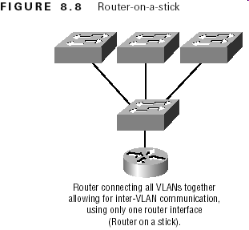
Routing Between VLANs

Slide 15
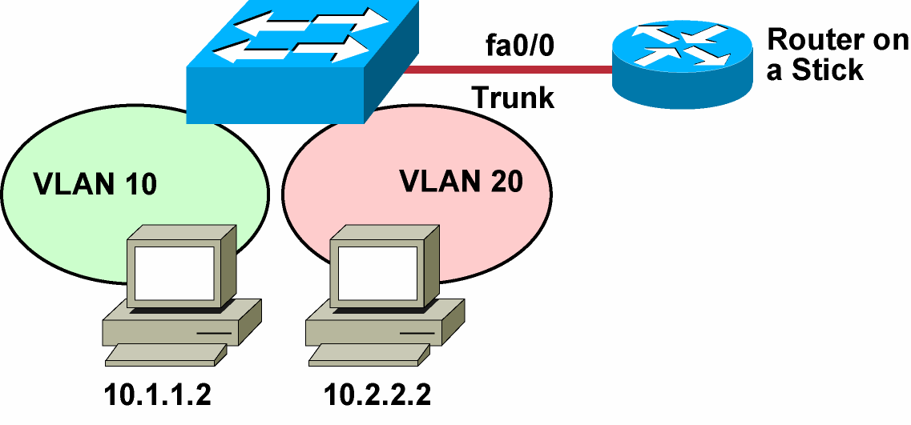
Router on a Stick
The router can support a single trunk for multiple VLANs.
Notes:
Purpose: This slide discusses the solution of ISL.
Emphasize:
The Inter-Switch Link (ISL) protocol is used to inter-connect two VLAN-capable Fast Ethernet devices, such as the Catalyst 5000 or Cisco 7500 routers. The ISL protocol is a packet-tagging protocol that contains a standard Ethernet frame and the VLAN information associated with that frame.
ISL is currently supported over Fast Ethernet links, but a single ISL link, or trunk, can carry traffic from multiple VLANs.
The concept of ISL was discussed in the “Defining Common Workgroups” chapter. How to configure ISL links is discussed later in this chapter.
Discuss the example in the SG.
Transition: Following is a discussion of ISL links to single router.

Slide 16
Router on a Stick (Cont.)
Advantages:
Simple to implement using any combination of systems
Router provides communications between VLANs on remote switches
Disadvantages:
Single point of failure if only one router is used
Single traffic path can become congested
Network topology can cause performance issues

Slide 17
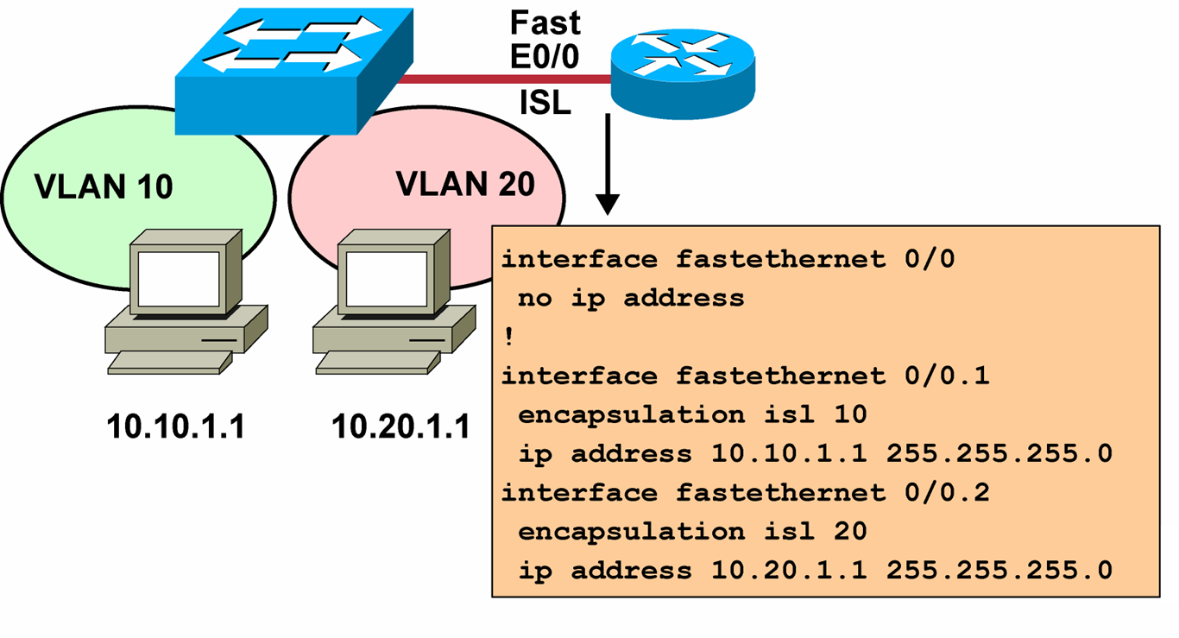
Router on a Stick Between VLANs with ISL Trunks
Notes:
Purpose: This figure shows the configuration of the router on a stick.
Emphasize: Highlight the two different interconnecting networks, 10.1.1.0 and 10.2.2.0.

Slide 18
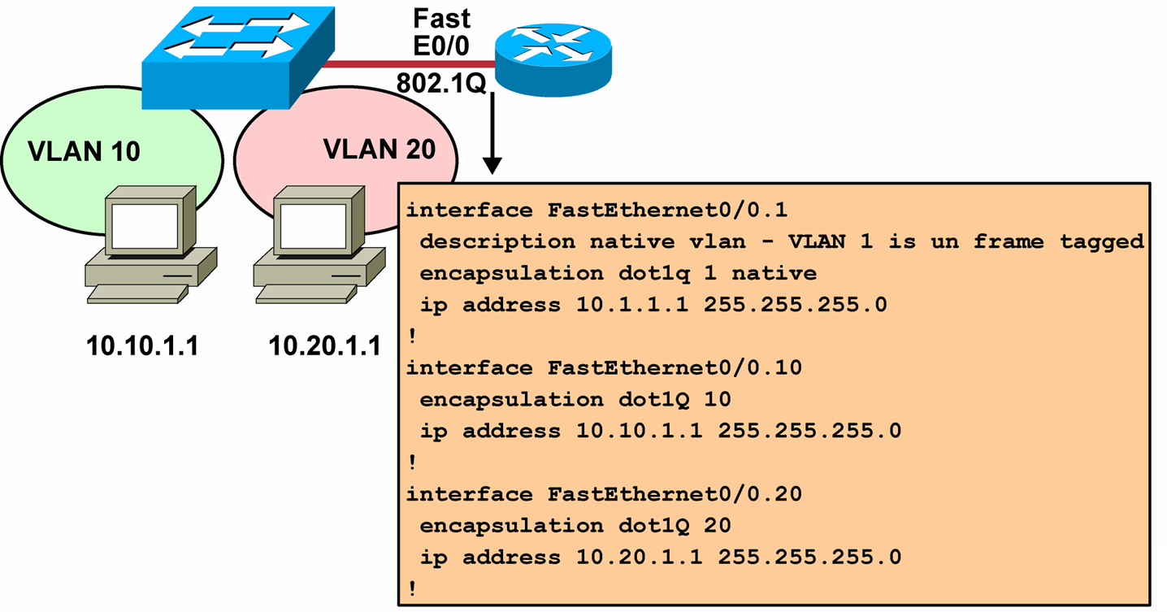
Router on a Stick Between VLANs with 802.1Q Trunks
Notes:
Purpose: This figure shows the configuration of the router on a stick.
Emphasize: Highlight the two different interconnecting networks, 10.1.1.0 and 10.2.2.0.

Slide 19
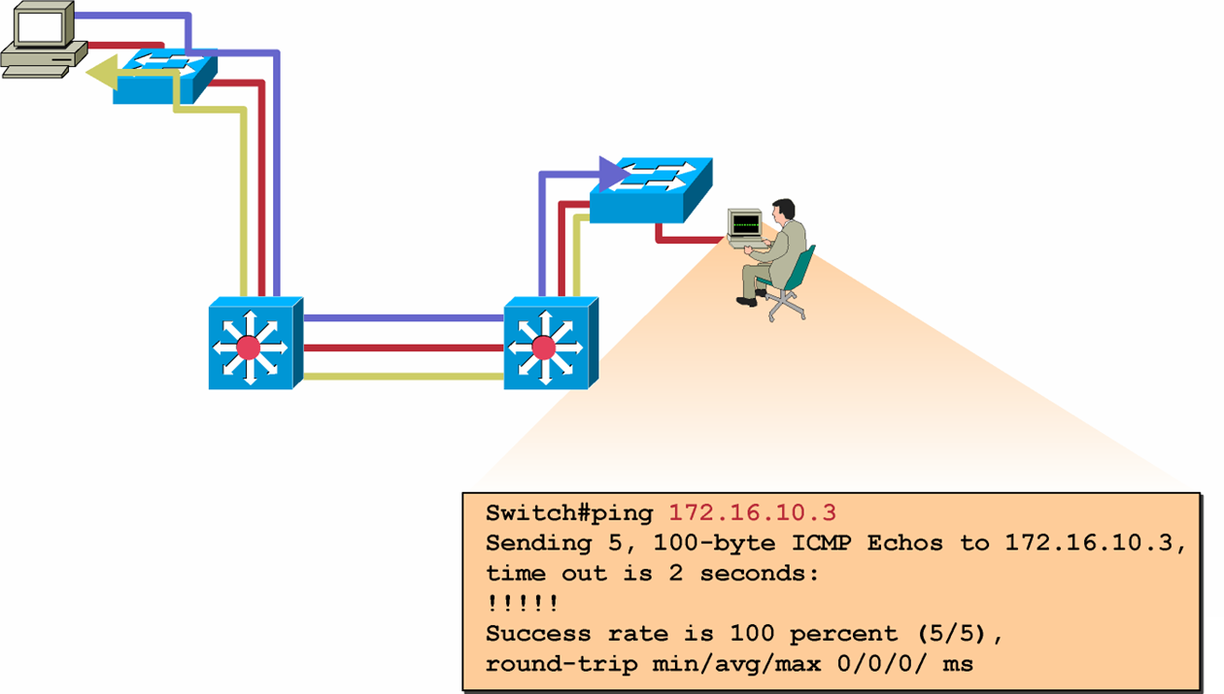
Verifying Inter-VLAN Routing
ping tests connectivity to remote hosts.
Notes:
Purpose: This slide discusses the ping command.
Emphasize: Use the ping command to test connectivity to remote hosts.
The ping command will return one of the following responses:
Success rate is 100 percent or ip address is alive. This response occurs in 1 to 10 seconds, depending on network traffic and the number of ICMP packets sent.
Destination does not respond. No answer message is returned if the host does not
Unknown host. This response occurs if the targeted host does not exit
Destination unreachable. This response occurs if the default gateway cannot reach the specified network
Network or host unreachable. This response occurs if there is no entry in the route table for the host or network.
You can also test the routes packets will take from the route processor to a specific destination by using the trace ip destination command.
For more information on the trace ip command, refer to the Cisco IOS Release 12.0 Command Summary .
Transition: Following is the visual for the laboratory exercise.

Slide 20
Verifying the Inter-VLAN Routing Configuration
Switch#show running-config
Displays the current configuration
Switch#show ip route
Displays IP route table information
Switch#show ip protocols
Displays IP routing protocol information

Slide 21
Lab Examples / Practice

Slide 22
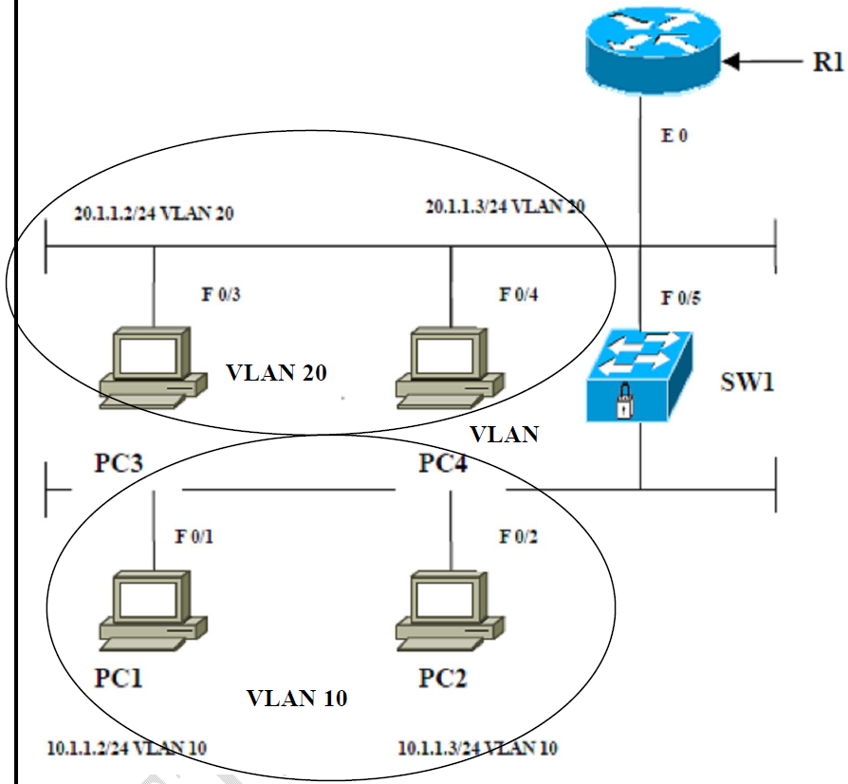
Lab#01: Scenario for Inter VLAN Routing

Slide 23
Configuration
ON router (R1)
Router (config) # Int e 0
Router (config-if ) # No ip address
Router (config-if ) # exit
Router (config) # Int e 0/0.10
Router (config-sub-if ) # Encapsulation dotlq 10
Router (config-sub-if ) # Ip address 10.1.1.1 255.0.0.0
Router (config-sub-if ) # exit
Router (config) # Int e 0/0.20
Router (config-sub-if ) # Encapsulation dotlq 20
Router (config-sub-if ) # Ip address 20.1.1.1 255.0.0.0

Slide 24
ON SW1
Switch# vlan database
Switch(vlan)# vlan 10 name sales
Switch(vlan)# exit
Switch# vlan database
Switch(vlan)# vlan 20 name finance
Switch(vlan)# exit
Switch(config)# Int fa0/1
Switch(config-if)# Switchport mode access
Switch(config-if)# Switchport access vlan10
Switch(config-if)# exit

Slide 25
Switch(config)# Int fa0/2
Switch(config-if)# Switchport mode access
Switch(config-if)# Switchport access vlan10
Switch(config-if)# exit
Switch(config)# Int fa0/3
Switch(config-if)# Switchport mode access
Switch(config-if)# Switchport access vlan20
Switch(config-if)# exit
Switch(config)# Int fa0/4
Switch(config-if)# Switchport mode access
Switch(config-if)# Switchport access vlan20
Switch(config-if)# exit

Slide 26
Switch(config)# Int fa0/5
Switch(config-if)# Shutdown
Switch(config-if)# Switchport trunk encapsulation dot1q
Switch(config-if)# Switchport mode trunk
Switch(config-if)# Switchport nonegotiate
Switch(config-if # No shutdown
Switch(config-if)# exit

Slide 27
Verification :
Verify if PC’s in VLAN 10 can communicate with PC’s in VLAN 20 using Ping

Slide 28
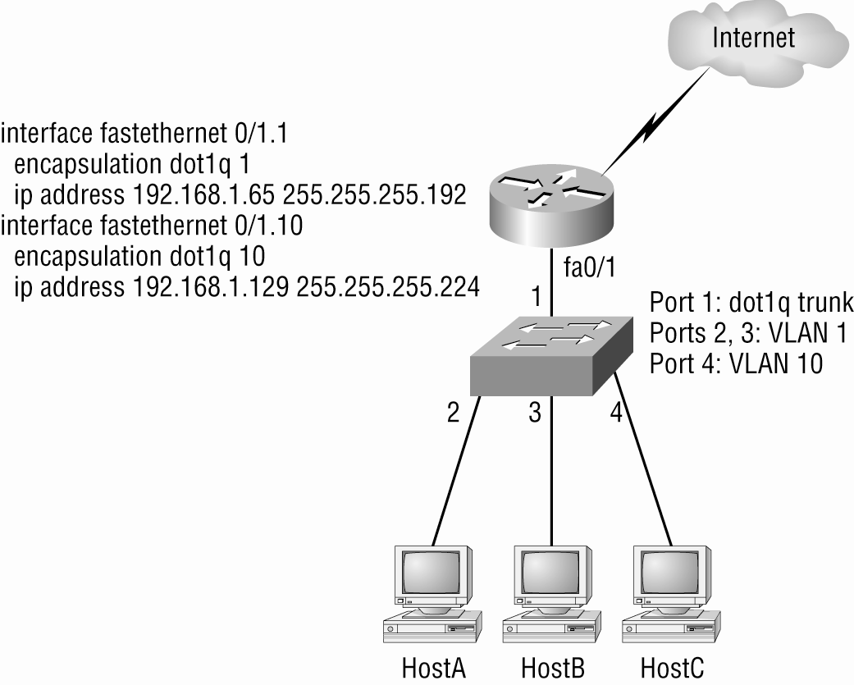
InterVLAN Configuration Example#2

Slide 29
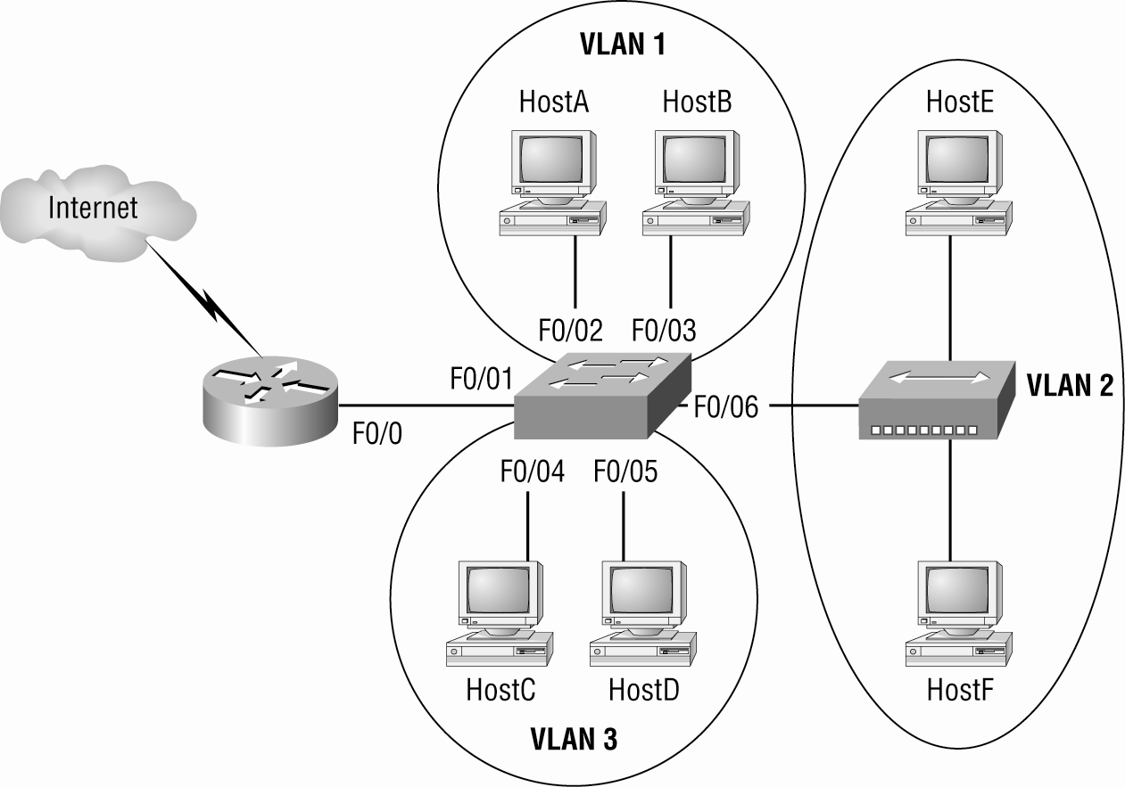
Example 3

Slide 30
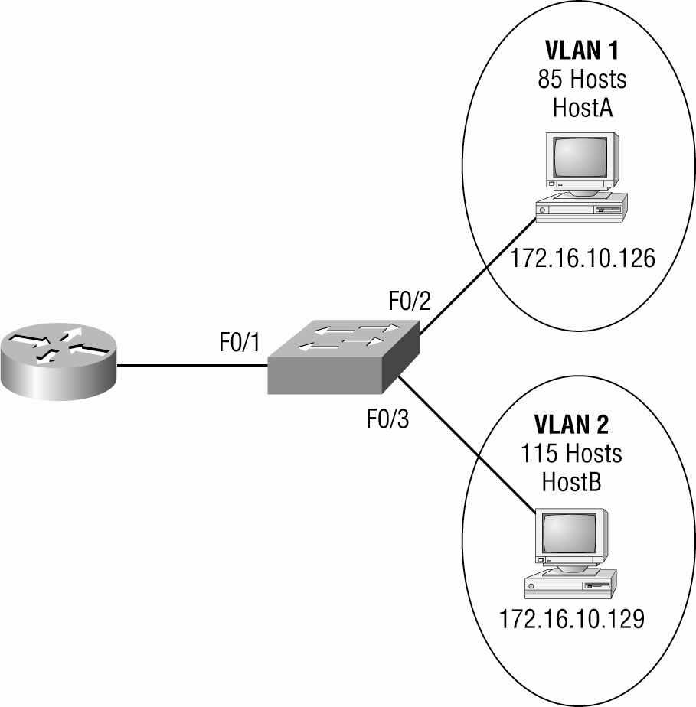
Example 4

Slide 31
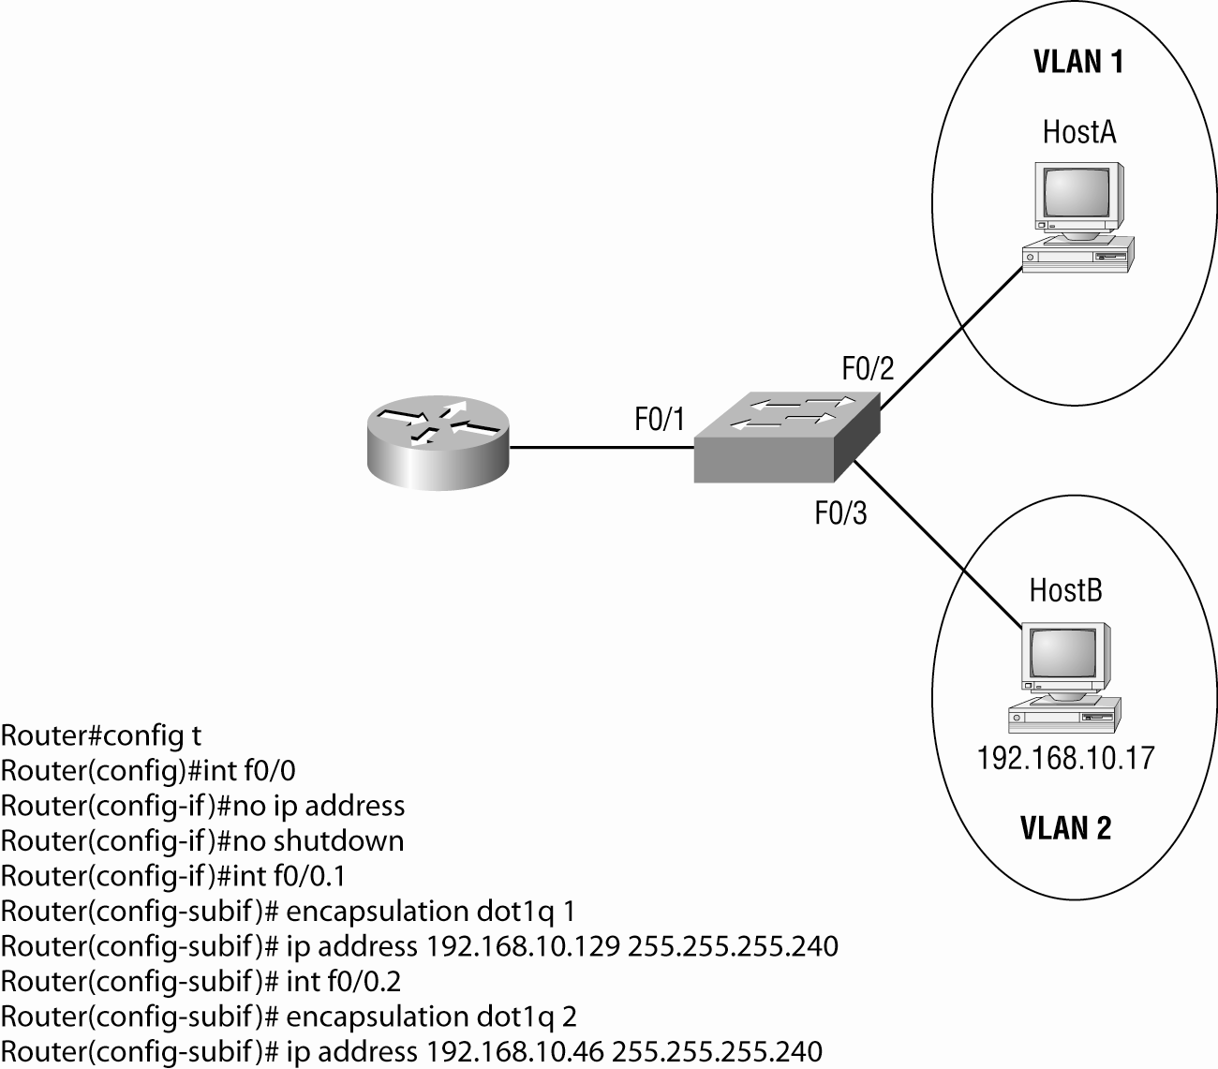
Example 5

Slide 32
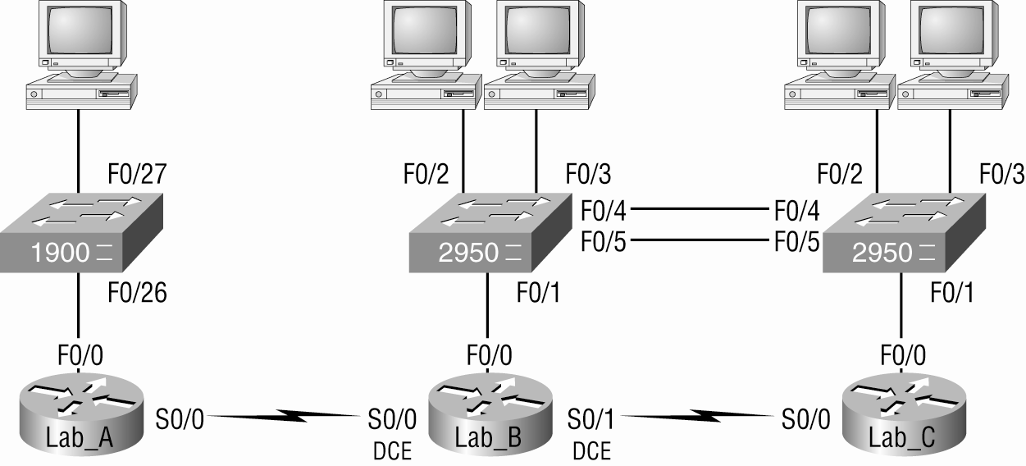
Configuring Switching In Our Sample Internetwork

Slide 33
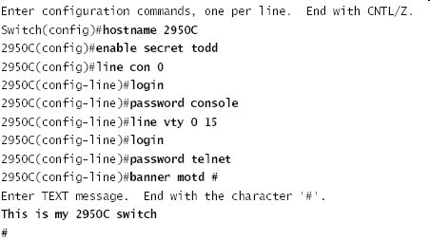
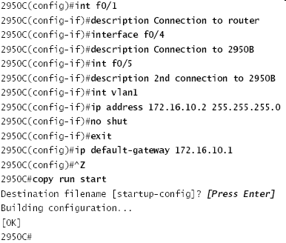
2950C

Slide 34
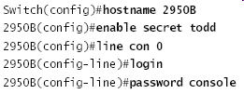
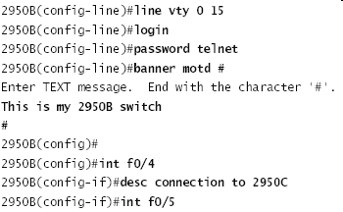
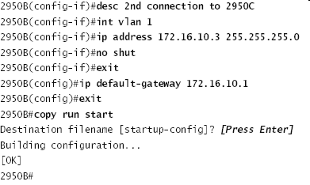
2950B

Slide 35
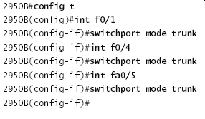
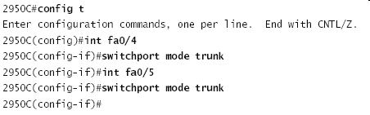
Setting Up Trunking

Slide 36
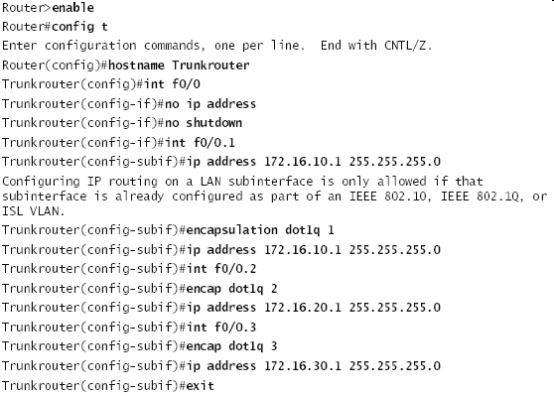
Inter-VLAN communication

